Slide 1
Thesis Prospectus
Jiawen Liu
Advised by: Marco Gaboardi

Slide 2
Outline
Introduction
Adaptivity Analysis
Query-While Language
Execution-Based Program Adaptivity Analysis
Static Program Adaptivity Analysis
Further Works
Adaptivity Analysis Framework Extension
Towards Accurate Program Quantitative Property Analysis
Status and Plan

Slide 3
Introduction to Data Analysis - Structure
discover / predicate
unknown population
data set
X
Combination of multiple queries over X
analysis result
sample
request query on X
Data Analysis

Slide 4


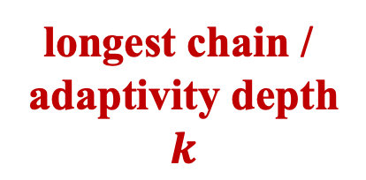


Adaptive Data Analysis – Simple Example
input
X
$${query}_{1} (X)$$
some queries rely on the results of other queries
longest chain /
adaptivity depth
$$k$$
$${query}_{2}( ,X)$$
$${query}_{3}( ,X)$$
…
output
analysis
results
$${query}_{k}( ,X)$$

Slide 5
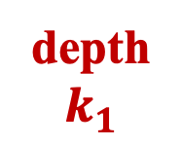





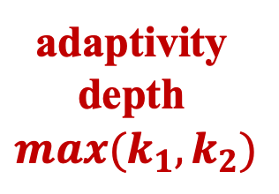

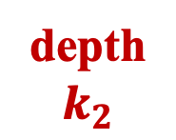
Adaptive Data Analysis – non-Trivial Example
input
X
$${query}_{1}(X)$$
$${query}_{2}(X)$$
$${query}_{3}(X)$$
$${query}_{4}( ,X)$$
$${query}_{5}( ,X)$$
adaptivity depth
$$max(k_{1}, k_{2})$$
depth
$$k_{1}$$
depth
$$k_{2}$$
…
…
…
$${query}_{n}( ,X)$$
analysis
results
output

Slide 6
Generalization Error / Overfitting
fits bad
genl. error
fits well
unknown population
data set
X
Combination of multiple queries over X
analysis result
sample
Data Analysis
Adaptivity in analysis will propagate the overfitting

Slide 7
Mechanisms for Reducing Generalization Error
Gaussian Mechanism
Laplace Mechanism
Threshold out
…
Guarantee generalization error
fits well
unknown population
data set
X
Mechanisms
analysis result
Combination of multiple queries over X
sample
Data Analysis
Guarantee will lose in multiple adaptive queries

Slide 8





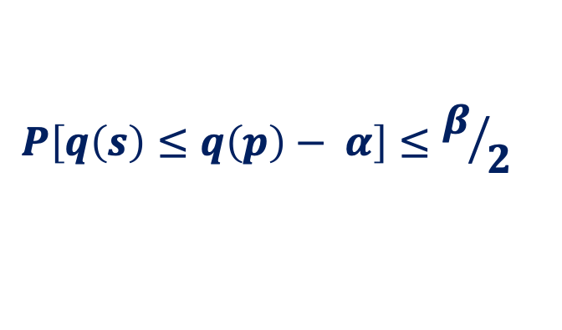
Theoretical Guarantee on Generalization Errors
Sample
Distribution
$$S$$
$$P$$
$$q(S)$$
$$\sim$$
$$q(P)$$
$$P\left[q\left(s\right)≤q\left(p\right)− α\right]≤β/2$$

Slide 9
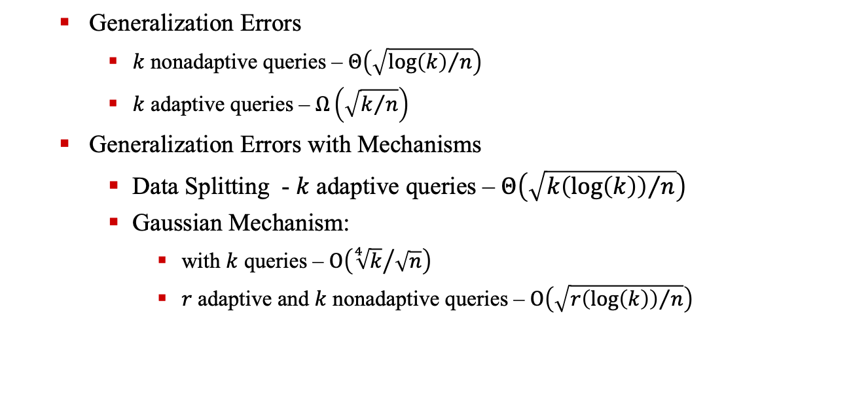
Theoretical Guarantee on Generalization Errors in Adaptive Data Analysis
Generalization Errors
$k$ nonadaptive queries – $Θ\left(\sqrt{{\log\left(k\right)}/n}\right)$
$k$ adaptive queries – $Ω\left(\sqrt{k/n}\right)$
Generalization Errors with Mechanisms
Data Splitting - $k$ adaptive queries – $Θ\left(\sqrt{{k\left(\log\left(k\right)\right)}/n}\right)$
Gaussian Mechanism:
with $k$ queries – $Ο\left({\sqrt[4]{k}}/{\sqrt{n}}\right)$
$r$ adaptive and $k$ nonadaptive queries – $Ο\left(\sqrt{{r\left(\log\left(k\right)\right)}/n}\right)$

Slide 10
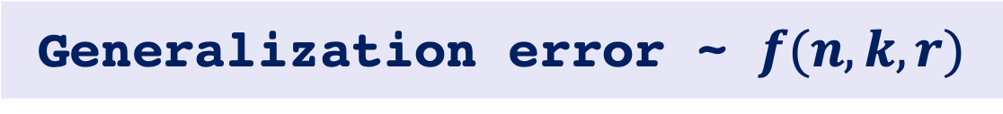
Motivation for Analyzing the Adaptive Data Analysis Program
Generalization error ~ $f(n, k, r)$
?
Formal Verification
or Analysis
Theory proofs
Algorithm
implementation
program

Slide 11
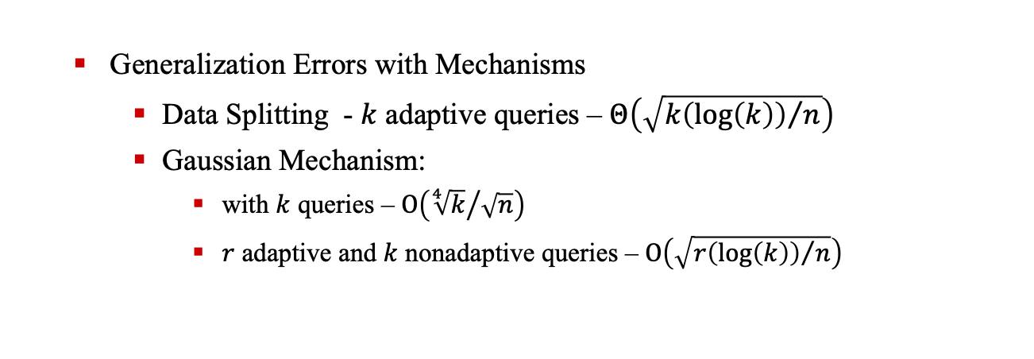
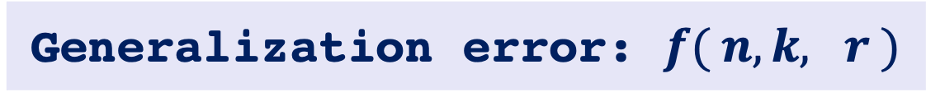
Motivation For Analysis Program’s Adaptivity Rounds
Generalization error: $f( n, k, r )$
Generalization Errors with Mechanisms
Data Splitting - $k$ adaptive queries – $Θ\left(\sqrt{{k\left(\log\left(k\right)\right)}/n}\right)$
Gaussian Mechanism:
with $k$ queries – $Ο\left({\sqrt[4]{k}}/{\sqrt{n}}\right)$
$r$ adaptive and $k$ nonadaptive queries – $Ο\left(\sqrt{{r\left(\log\left(k\right)\right)}/n}\right)$

Slide 12
Motivation For Analysis Program’s Adaptivity Rounds
Adaptivity
Where to apply mechanisms
How many mechanisms needed
Light or intense mechanism
…
Guarantee Generalization Error

Slide 13
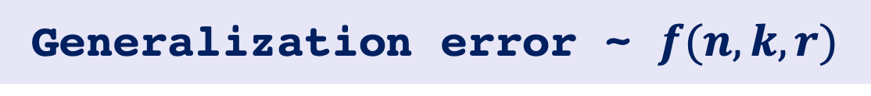
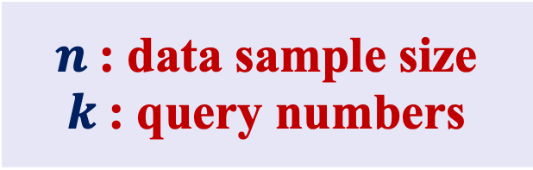
Motivation For Analysis Adaptivity Quantity
Generalization error ~ $f(n, k, r)$
Easily Track
Challenge
$n$: data sample size
$k$: query numbers
Adaptive query numbers

Slide 14
Research Challenges &. Goals
input
X
$${query}_{1}(X)$$
$${query}_{2}(X)$$
$${query}_{3}(X)$$
$${query}_{4}( ,X)$$
$${query}_{5}( ,X)$$
adaptivity depth
$$max(k_{1}, k_{2})$$
depth
$$k_{1}$$
depth
$$k_{2}$$
…
…
…
$${query}_{n}( ,X)$$
analysis
results
output

Slide 15
Research Challenges &. Goals
Challenge – I : Adaptive Data Analysis Formalization
Query-While Language Design
Challenge – II : Adaptivity Formalization
Execution-Based Adaptivity Analysis
Challenge – III : Adaptivity Estimation
Static Program Adaptivity Analysis

Slide 16
Adaptivity Analysis Framework

Slide 17
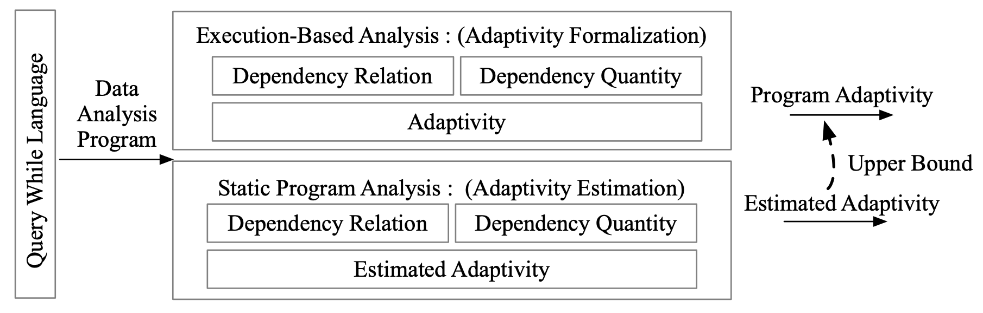
Adaptivity Analysis Framework

Slide 18
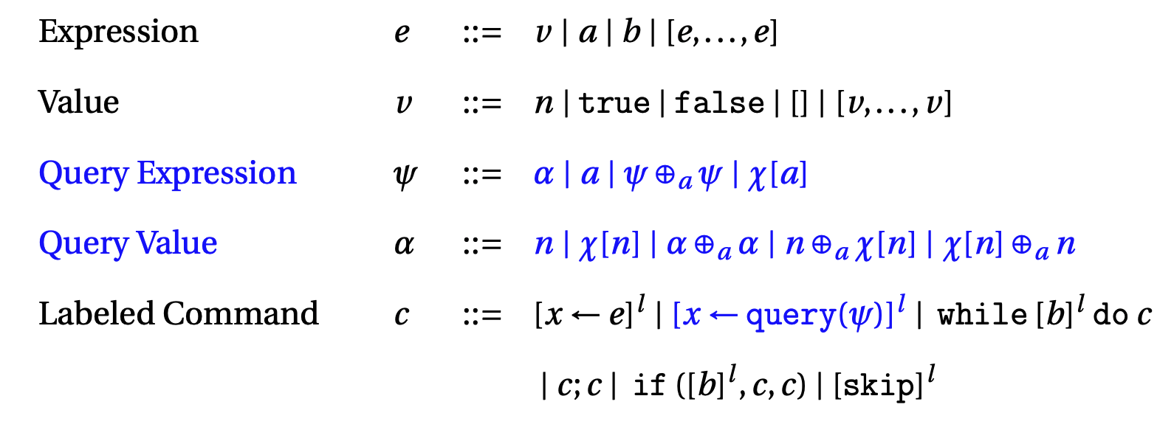
Query-While Language Design

Slide 19
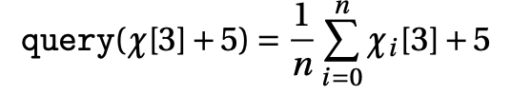
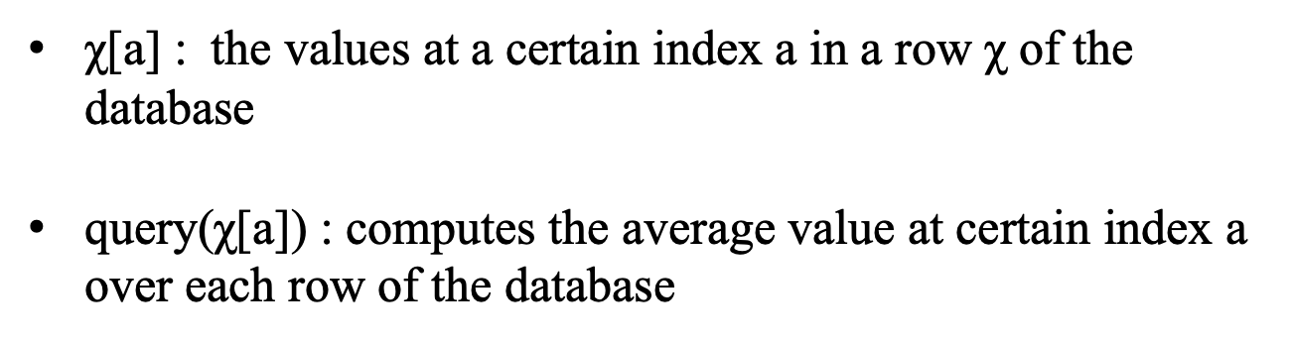
Query-While Language Design – Query Expression
χ[a] : the values at a certain index a in a row χ of the database
query(χ[a]) : computes the average value at certain index a over each row of the database

Slide 20
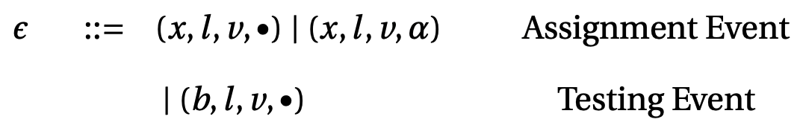

Query-While Language Design – Trace-based Semantics
Event
Trace

Slide 21
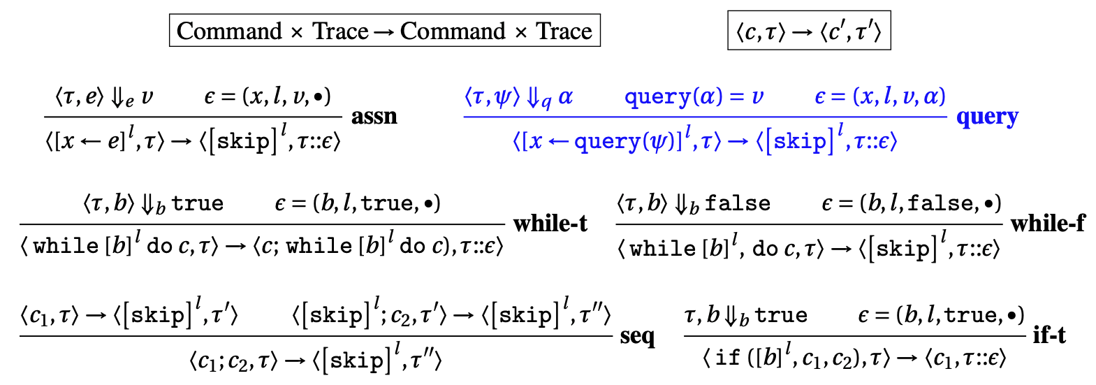
Query-While Language Design – Trace-based Semantics
Operational Semantics Rules

Slide 22
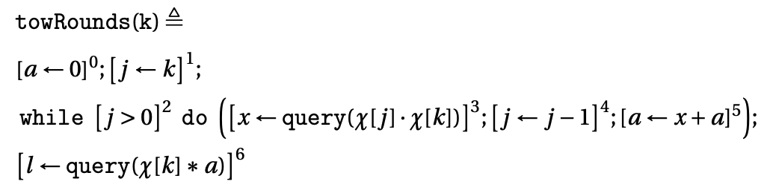
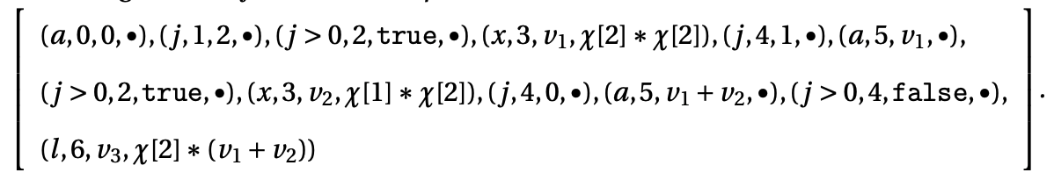
Example - Evaluation Trace
Evaluation Trace: (initial trace: (k, in, 2, •))

Slide 23
Execution-Based Adaptivity Analysis
Data Dependency Relation Analysis
Data Dependency Quantity Analysis
Adaptivity Formalization

Slide 24
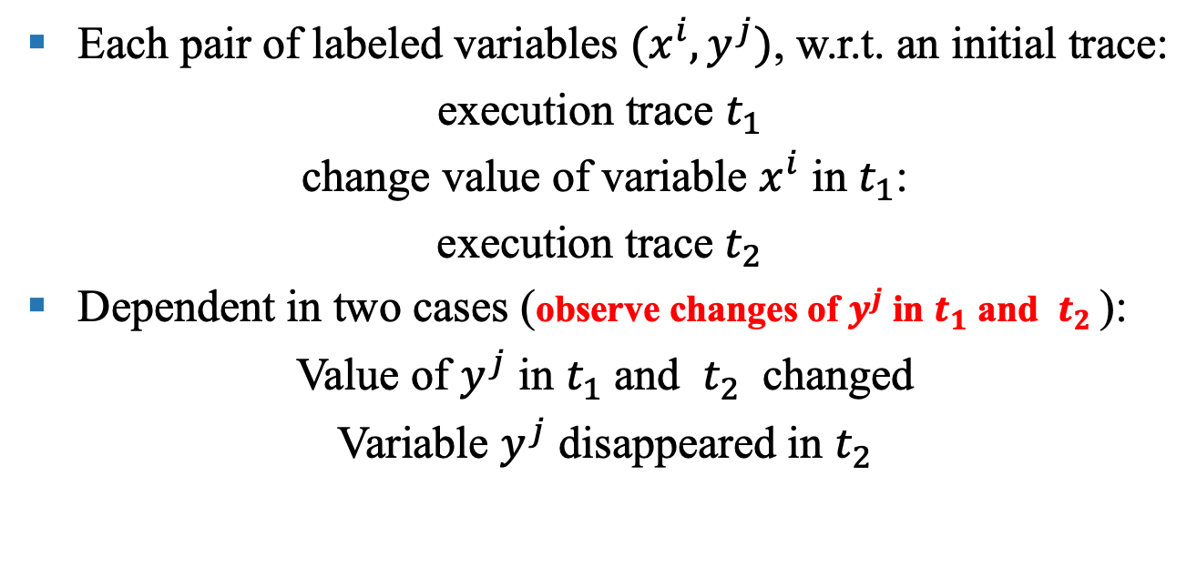
Data Dependency Relation Analysis
Each pair of labeled variables ${(x}^{i}, y^{j})$, w.r.t. an initial trace:
execution trace $t_{1}$
change value of variable $x^{i}$ in $t_{1}$:
execution trace $t_{2}$
Dependent in two cases (observe changes of $y^{j}$ in $t_{1}$ and $t_{2}$):
Value of $y^{j}$ in $t_{1}$ and $t_{2}$ changed
Variable $y^{j}$ disappeared in $t_{2}$

Slide 25
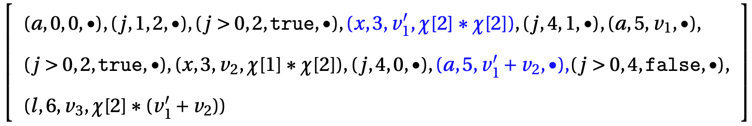
Example - Dependency Relation
Dependency relation for x3 and a5

Slide 26

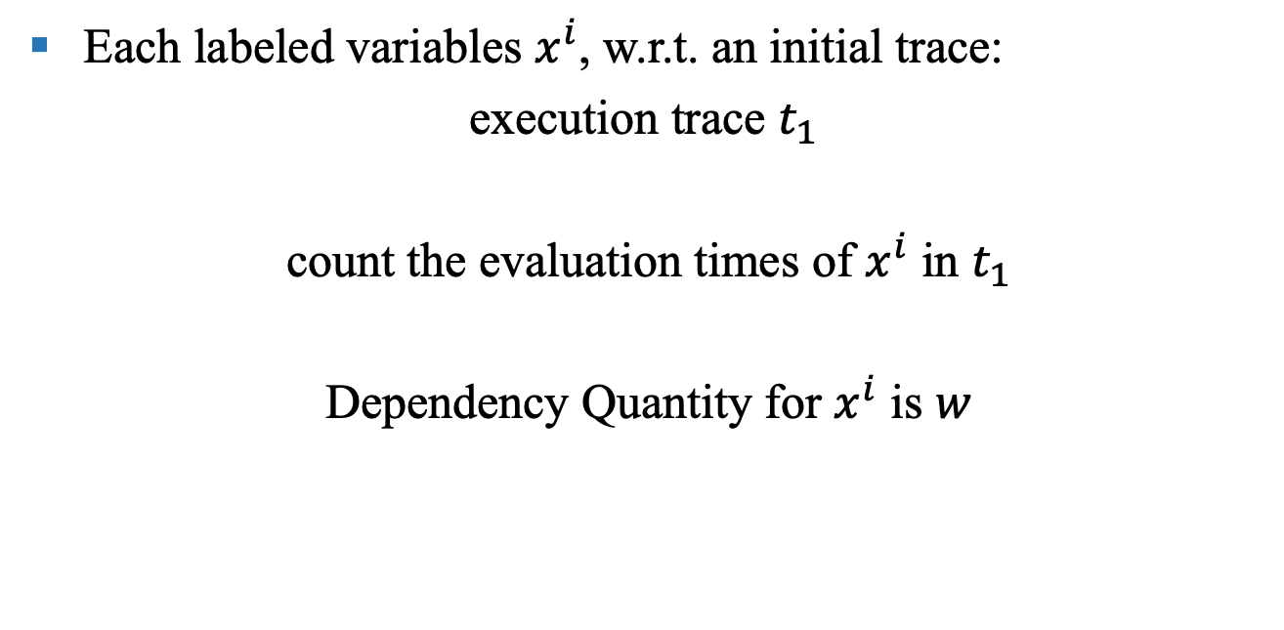

Dependency Quantity Analysis
Each labeled variables $x^{i}$, w.r.t. an initial trace:
execution trace $t_{1}$
count the evaluation times of $x^{i}$ in $t_{1}$
Dependency Quantity for $x^{i}$ is $w$
$$t_{1}$$
$$w$$

Slide 27
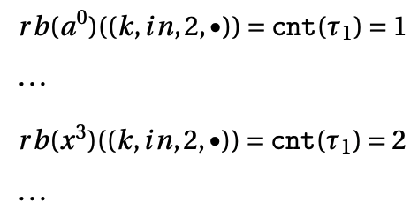
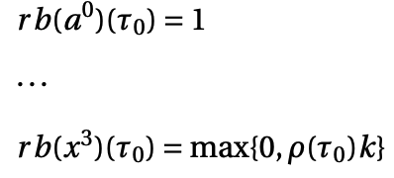

Example - Dependency Quantity
Dependency Quantity for a0 and x3
initial trace: (k, in, 2, •)
arbitrary initial trace $t_{0}$

Slide 28
Adaptivity Formalization
Step 1 - Construct Dependency Graph
vertex V(c) := Labeled Variables for c
edge E(c) := Dependency Relation for pair of labeled variables
weight W(c):= Dependency Quantity for each labeled variable
query annotation Q(c) := labeled variables assigned by query requests.
G(c) = (V(c), E(c), W(c), Q(c))

Slide 29
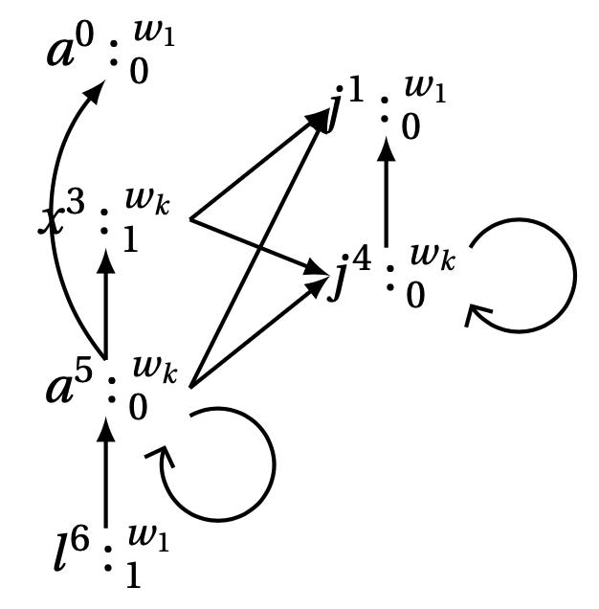
Adaptivity Formalization – Dependency Graph

Slide 30
Adaptivity Formalization
Step 2 - Adaptivity
Longest Finite Walk.
vertices sequence: (v0, …, vn)
edge sequence (e1, …, en), e_i = (v(i-1), vi) \in E(c)
# {vi | vi \in (v0, …, vn) } smaller than weight of vi in W(c)

Slide 31
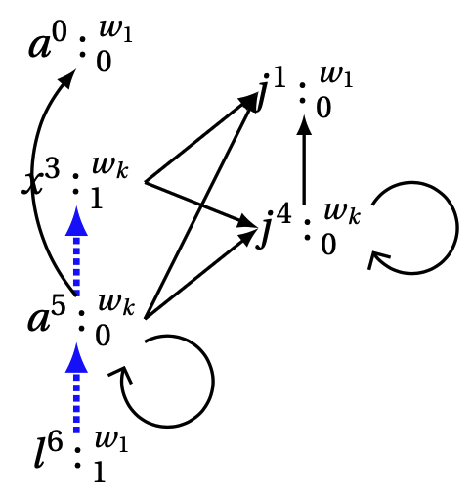
Adaptivity Formalization – Longest Finite Walk

Slide 32
Static Program Adaptivity Analysis
Data Dependency Relation Estimation
Data Dependency Quantity Estimation
Adaptivity Estimation
Control Flow and Program Abstract Based Static Analysis

Slide 33
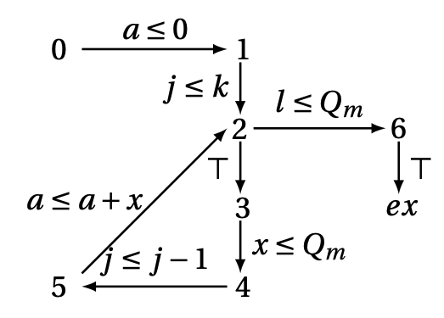
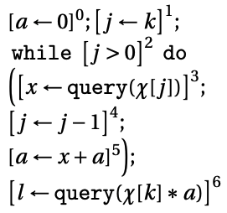
Base Step
Example - Abstract Control Flow Graph

Slide 34
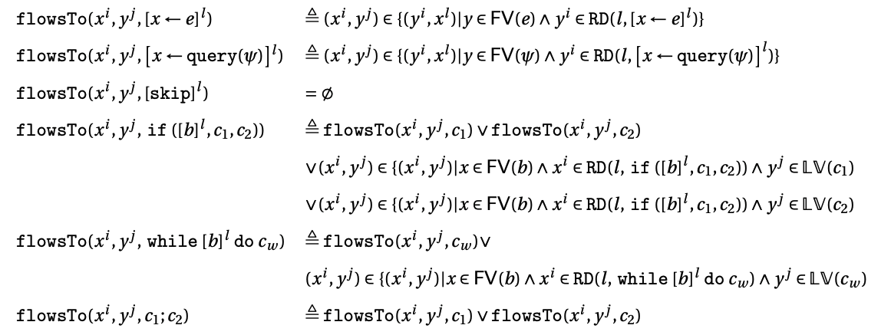
Data Dependency Relation Estimation
Standard Reaching Definition Algorithm

Slide 35
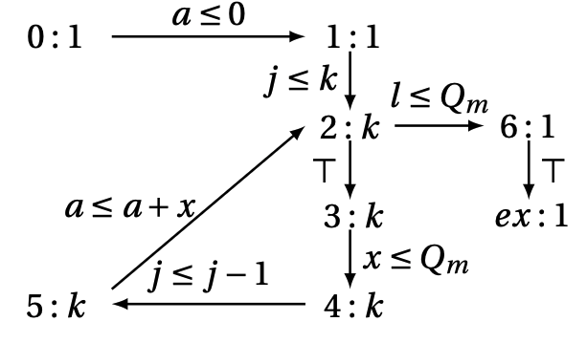
Dependency Quantity Estimation
Reachability Bound Analysis

Slide 36
Adaptivity Estimation
Step 1 - Dependency Graph Estimation
vertex := Labeled Variables in c
edge := Feasible Data Flow Relation
weight := Reachability Bound for each labeled variable
query annotation := labeled variables assigned by query requests.
Step 2 – Longest Finite Walk Estimation

Slide 37
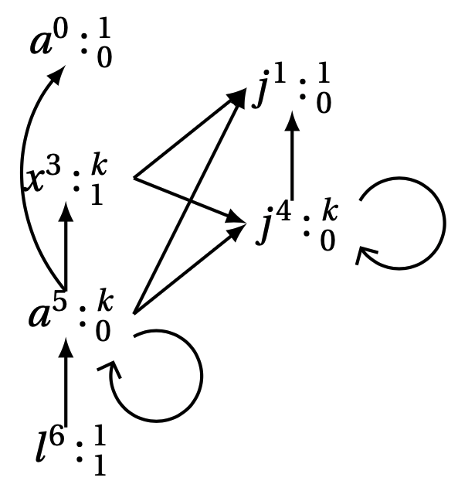
Adaptivity Estimation –Dependency Graph Estimation

Slide 38
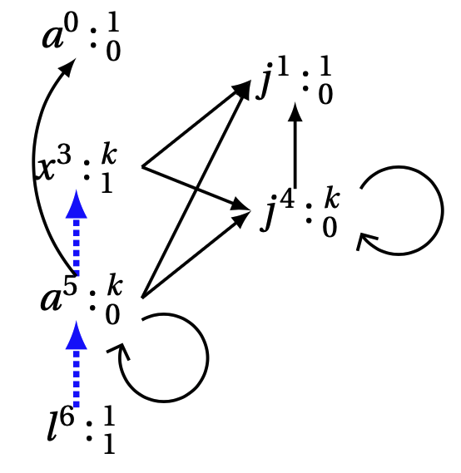
Adaptivity Estimation –Longest Finite Walk Estimation

Slide 39
Further Works

Slide 40
Adaptivity Analysis Framework Extension
Language Extension
Execution-Based Analysis Extension and Improvement
Extend with inter-procedure call
Analyze the quantity of Dependency Edge in Graph
Static Analysis Extension and Improvement
Extend with inter-procedure call
Design Path Sensitive Reachability Bound Algorithm
Estimate the Quantity of Dependency Edge in Graph

Slide 41
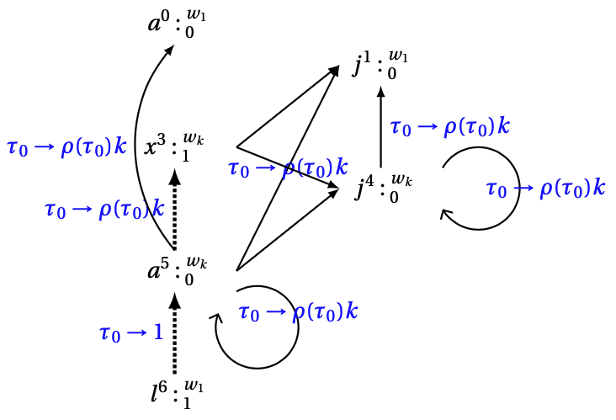
Execution-Based Analysis Extension and Improvement

Slide 42
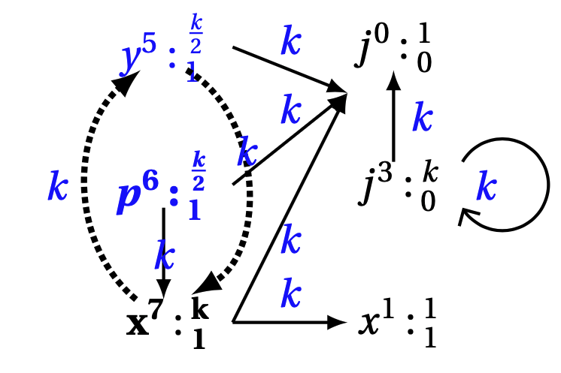
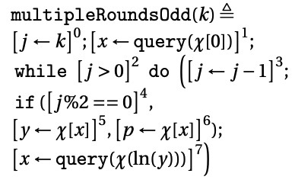
Static Analysis Extension and Improvement
Path Sensitive Reachability Bound Analysis

Slide 43
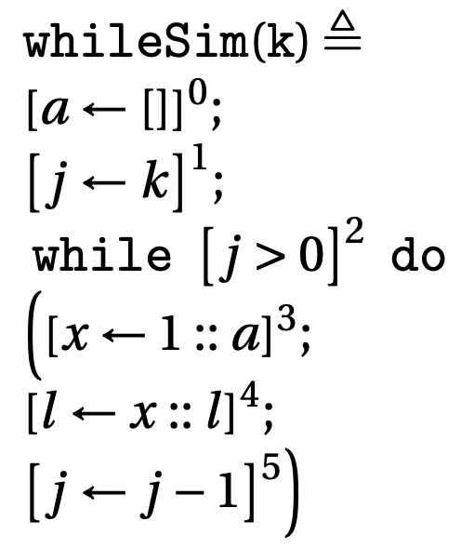
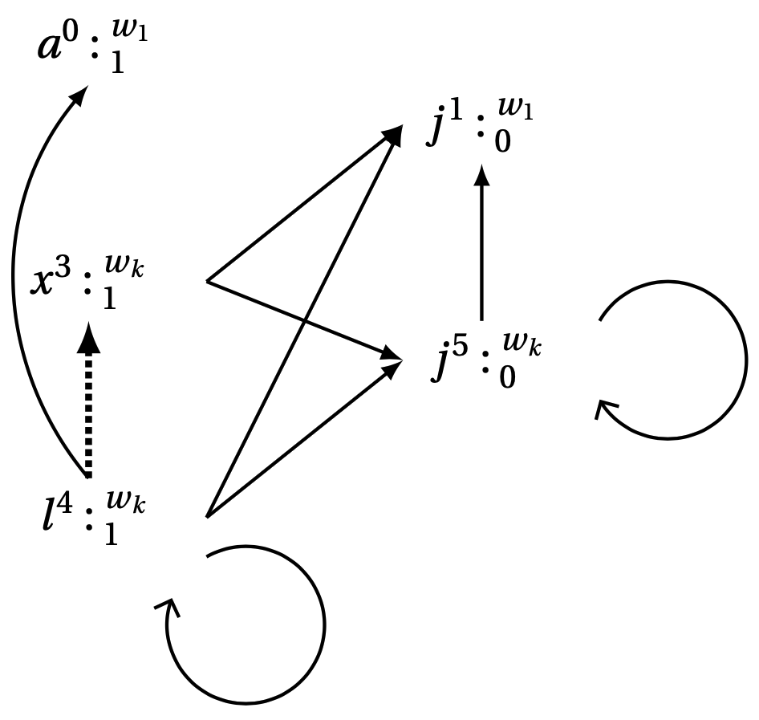
Accurate Analysis Framework for Quantitative Property
List Length

Slide 44
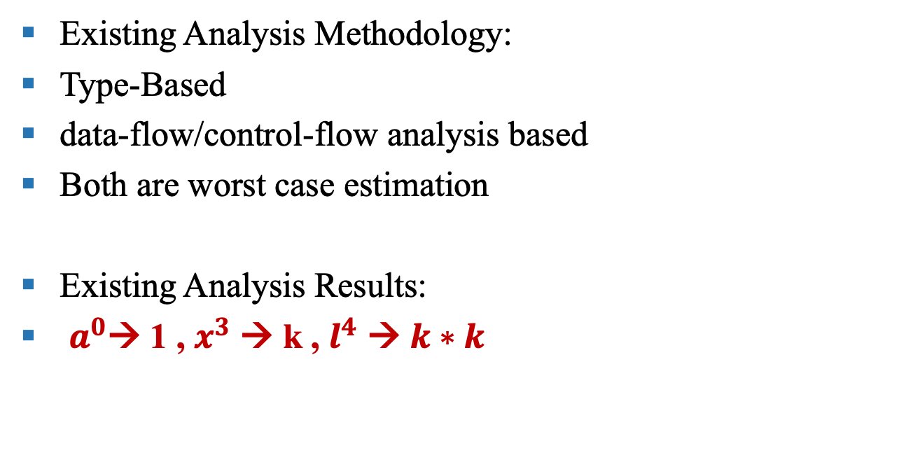
Accurate Analysis Framework for Quantitative Property
Existing Analysis Methodology:
Type-Based
data-flow/control-flow analysis based
Both are worst case estimation
Existing Analysis Results:
$a^{0}$→ 1 , $x^{3}$ → k , $l^{4}$ → $k∗k$

Slide 45
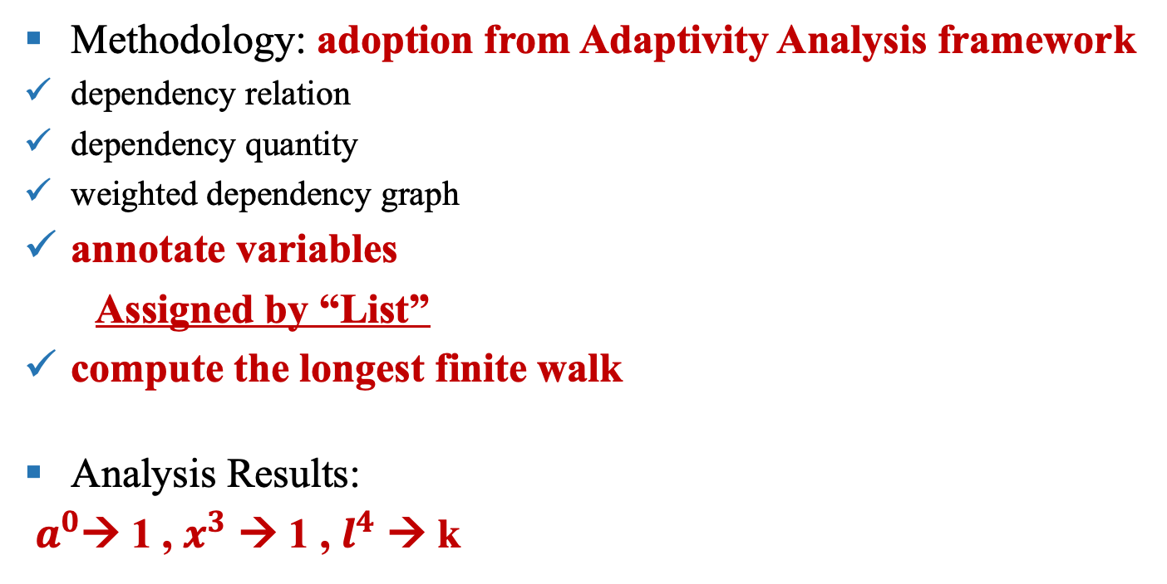
Accurate Analysis Framework for Quantitative Property
Methodology: adoption from Adaptivity Analysis framework
dependency relation
dependency quantity
weighted dependency graph
annotate variables
Assigned by “List”
compute the longest finite walk
Analysis Results:
$a^{0}$→ 1 , $x^{3}$ → 1 , $l^{4}$ → k

Slide 46
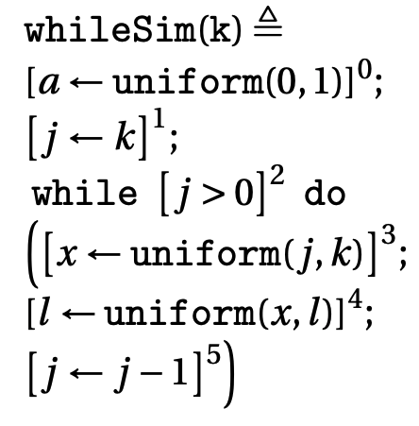
Accurate Analysis Framework for Quantitative Property
Joint Distribution

Slide 47
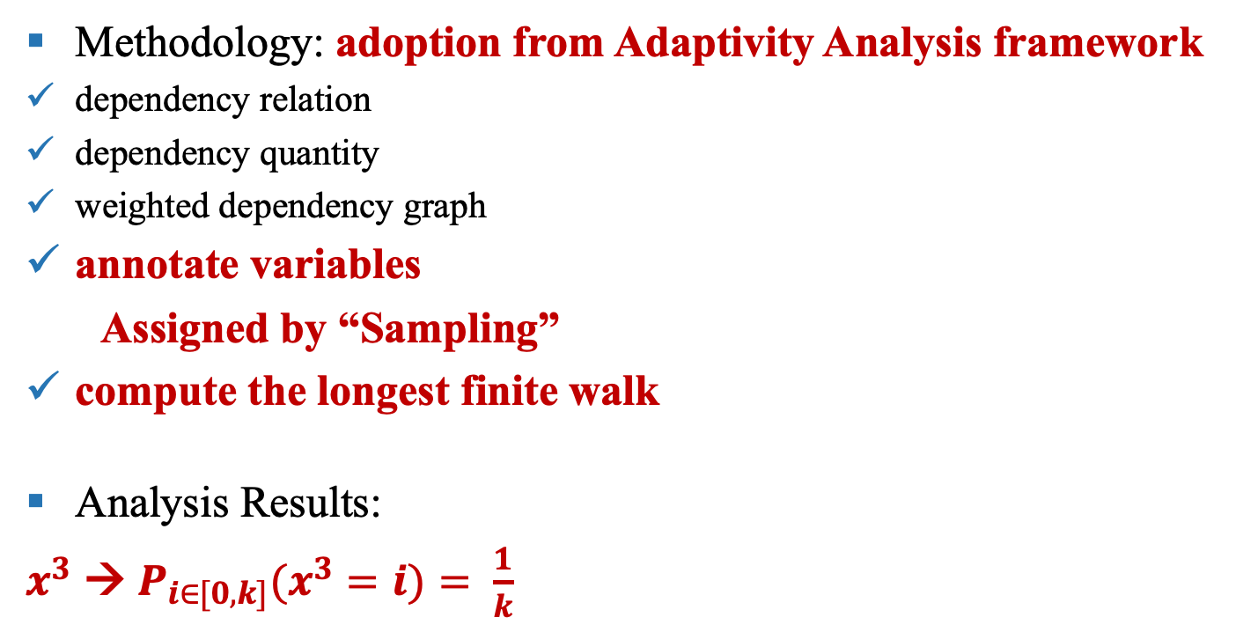
Accurate Analysis Framework for Quantitative Property
Methodology: adoption from Adaptivity Analysis framework
dependency relation
dependency quantity
weighted dependency graph
annotate variables
Assigned by “Sampling”
compute the longest finite walk
Analysis Results:
$x^{3}$ → $P_{i∈[0, k]}(x^{3}=i)= \frac{1}{k}$

Slide 48
Status and Plan

Slide 49
Status
The full-spectrum program adaptivity analysis is formalized into paper and submitted as a paper to POPL’2023.
It is also implemented and evaluated over three empirical data analysis algorithms and few designed examples.
Plan
September 05, 2022: Finishing the execution-based dependency analysis extension and implementation,
September 20, 2022: For the static adaptivity analysis extension, finishing the Path Sensitive Reachability Bound Algorithm design and implementation,
September 30, 2022: Generalizing this program analysis framework onto program’s different quantitative properties analysis.
October 15, 2022: Finish generalization on program resource cost analysis implementation and the reduction of CFL-Reachability problem.
November 05, 2022: Finalizing the Path Sensitive Reachability Bound Algorithm and submitting the paper to PLDI 2023
November 20, 2022: Finish thesis
December 05, 2022: Defend

